Slide 1
How to do an audit
Professor Anne-Maree Kelly
December 2020

Slide 2
What is an audit?
Audit in healthcare is a process used to assess, evaluate and improve care of patients in a systematic way.
Audit measures current practice against a defined (desired) standard.
It forms part of clinical governance, which aims to safeguard a high quality of clinical care for patients.

Slide 3
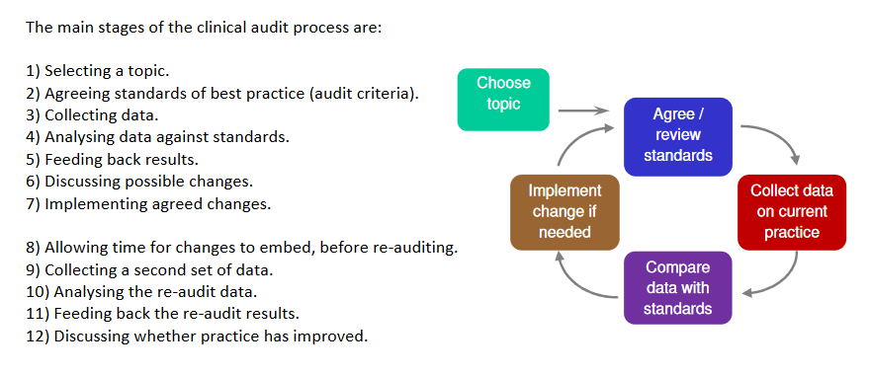
The audit process

Slide 4
AUDIT GOVERNANCE
BEFORE UNDERTAKING AN AUDIT:
All potential audit projects require approval by the site Director of Emergency Medicine AND
All approved projects need to be registered with the Audit, Research and Innovation Committee (link)

Slide 5
DEFINING your topic
You need to be quite specific about what you are auditing
Specify:
Who e.g. in patients with renal colic
What e.g. receive analgesia
When (not always necessary) e.g. within 60 minutes of ED presentation

Slide 6
DEFINING THE STANDARD OF CARE
Not every audit will involve a standard of care – some may be exploratory
If there is a well known standard (e.g. time to antibiotics in sepsis) use this, otherwise you need to define the desired outcomes based on evidence or consensus

Slide 7
Collecting data
It is important to decide what data you need – to comply with State privacy law you should collect the least that is necessary to address the question
It is helpful to write an audit plan before you start
Data questions
What patients will you include and how you will identify patients
What time period is involved
Where you will find the data you need
How will you code the data -- see separate presentation Coding Data (link)

Slide 8
Privacy Law and using data
The relevant privacy law in public hospitals in Australia is the Health Records Act 2001
Health Privacy Principle 2.2 (f) (i) allows health data to be used without patient consent for monitoring and evaluation of health services if that cannot be achieved using de-identified data
Note, there are separate requirements for use of health data for research which require approval of a human research ethics committee (see Health Privacy Principle 2.2 (g))

Slide 9
Is ethics approval required?
There is no sharp boundary between audit/quality assurance and research
Generally speaking audit/quality assurance requires ethics approval if:
It is intended to publish or report it outside the organisation (e.g. journal or conference)
There is a risk to the privacy or professional reputation of patients, professionals or the organisation
The project focusses on minorities or vulnerable groups
Health information is being used to answer a question not directly related to patient care (this is research)
Subgroup comparisons are being made (this is research)
Detailed advise is available at https://www.nhmrc.gov.au/sites/default/files/documents/attachments/ethical-considerations-in-quality-assurance-and-evaluation-activites.pdf

Slide 10
ANALYSIS AND REPORTING
A reporting template is available at: (link)
Email to <anne-maree.kelly@wh.org.au>
Most audit projects undertake simple descriptive analysis e.g. the proportion of x within the specified time frame
An audit report should include:
Title of the audit
Audit lead’s name
The audit question
Inclusion criteria
Time period audited
Results
An interpretation of the results – e.g. target being met/not, any relevant factors identified that could be targeted for improvement

Slide 11
If you have questions, email:
<anne-maree.kelly@wh.org.au>

